Slide 1
Navigating Ecommerce
SPECTRUM Ordering

Slide 2
Get Ecommerce Access if Needed
Make a Request On The Spot: https://thespot.mskcc.org/esc?id=sc_cat_item&sys_id=14735d01db19e850701a2a5913961940&sysparm_category=52fb5256db15e090701a2a5913961968
If The above link doesn’t work, follow this path:
https://thespot.mskcc.org/esc?id=esc_dashboard -> Click on IT -> Ecommerce -> MSK Ecommerce Coupa Support -> Fill Out Form
Once this is done, you will receive an email with instructions on what to do next.

Slide 3
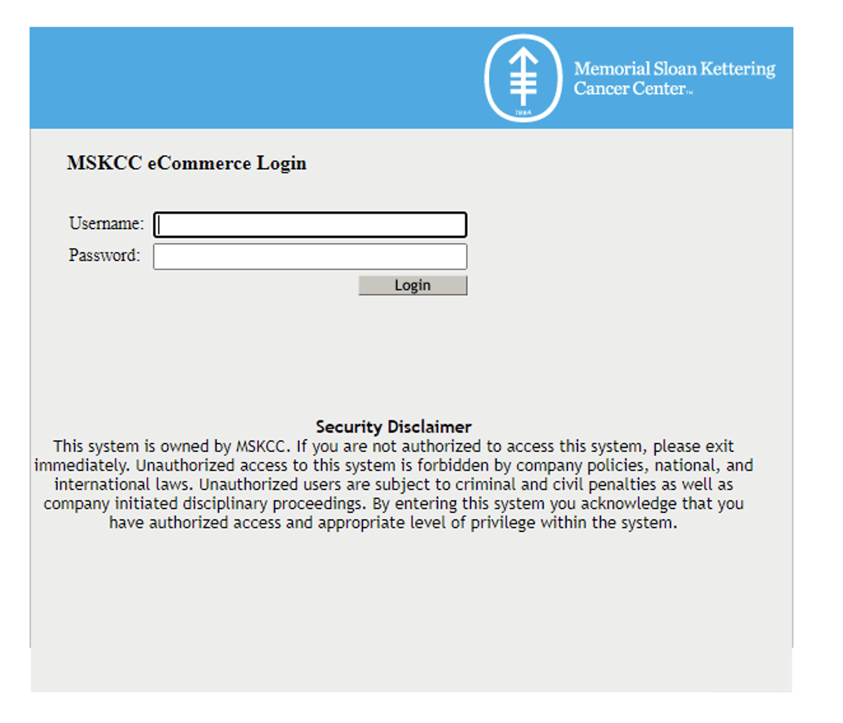
Ecommerce Login
Navigate to the MSK Ecommerce portal through OneMSK
Log in using your normal MSK credentials

Slide 4
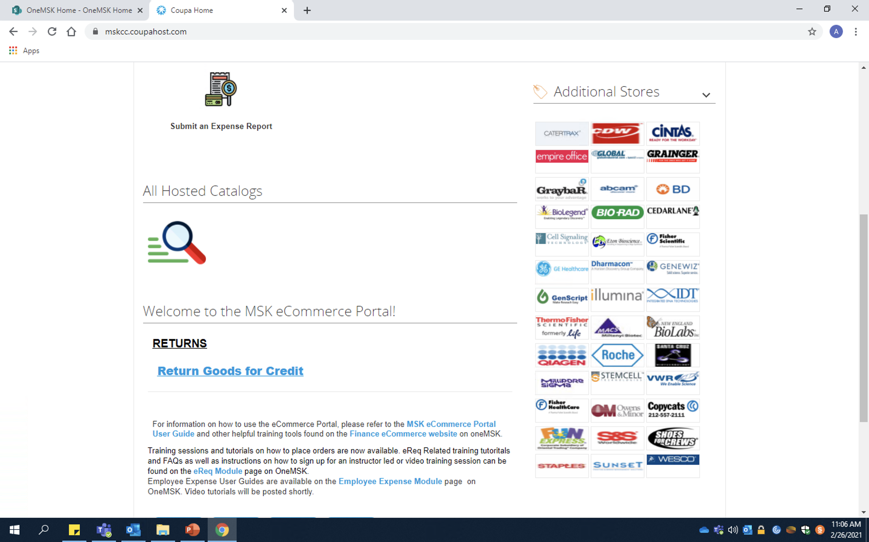
Ecommerce Home Page
Most common store links
– ThermoFrisher
– QiaGen
– Millapore Sigma (Sigma-Aldrich)
– Fisher Healthcare/Scientific
– Staples

Slide 5
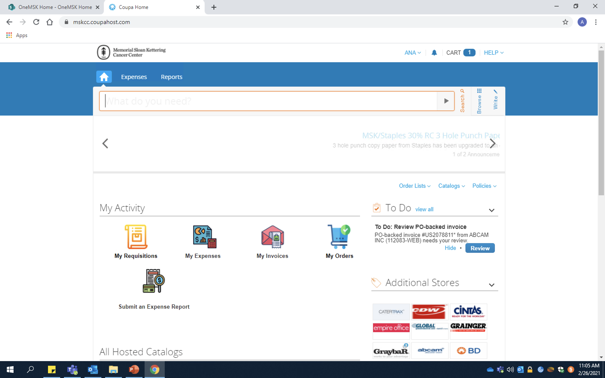
Search: Can search for items by name or by catalog number. Useful if you don’t know what store to order from
Ecommerce Home Page
Cart: Navigate or hover mouse here to review what items are in your cart
Write: Navigate here when an off-catalog order is required
Catalogs: Search here for in-catalog stores that do not appear in the fast links below

Slide 6
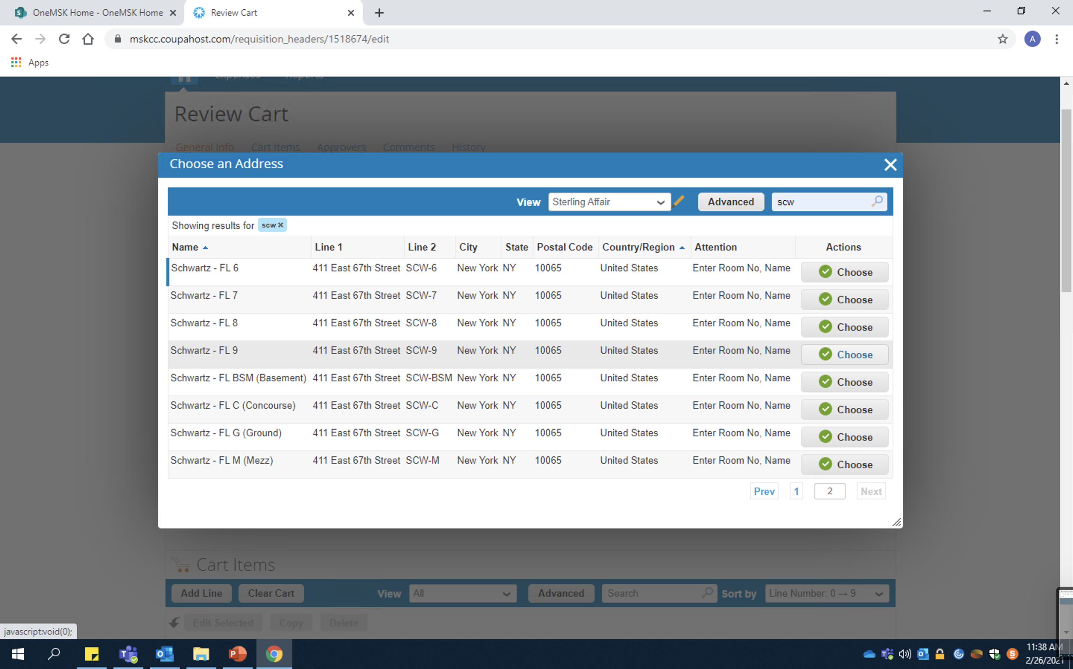
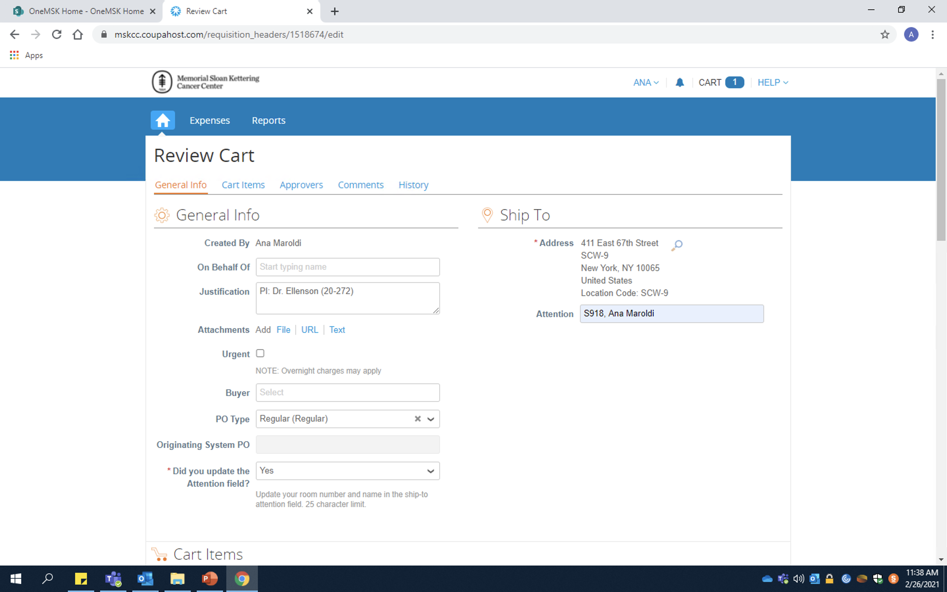
In-Catalog Orders
Navigate to the search icon, type “scw” for Schwartz into the search bar (top right) and find “Schwartz – FL 9” on the second page
Be sure to update the attention field with our room number and name (S918, name)

Slide 7
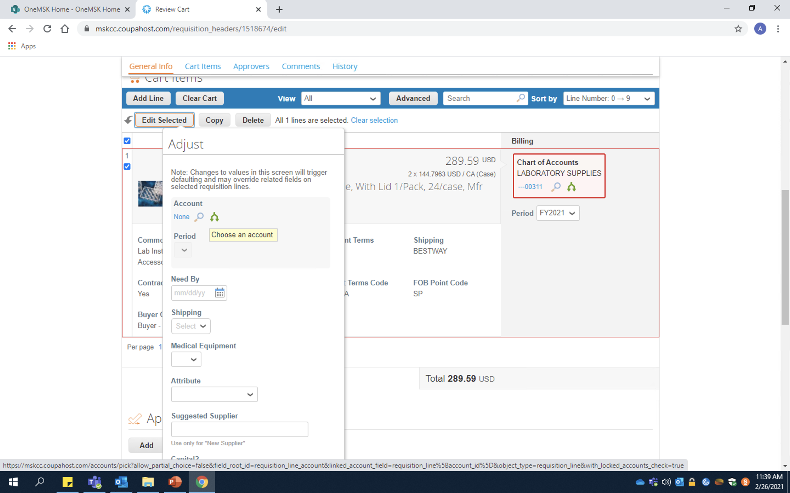
In-Catalog Orders
Highlight all items in your cart and click “Edit Selected”
Click the blue search button underneath the “Account” section. For SPECTRUM, the CC is 50400 and the fund # is 17421
Note: Do not try to find the account without using the search icon – it won’t work

Slide 8
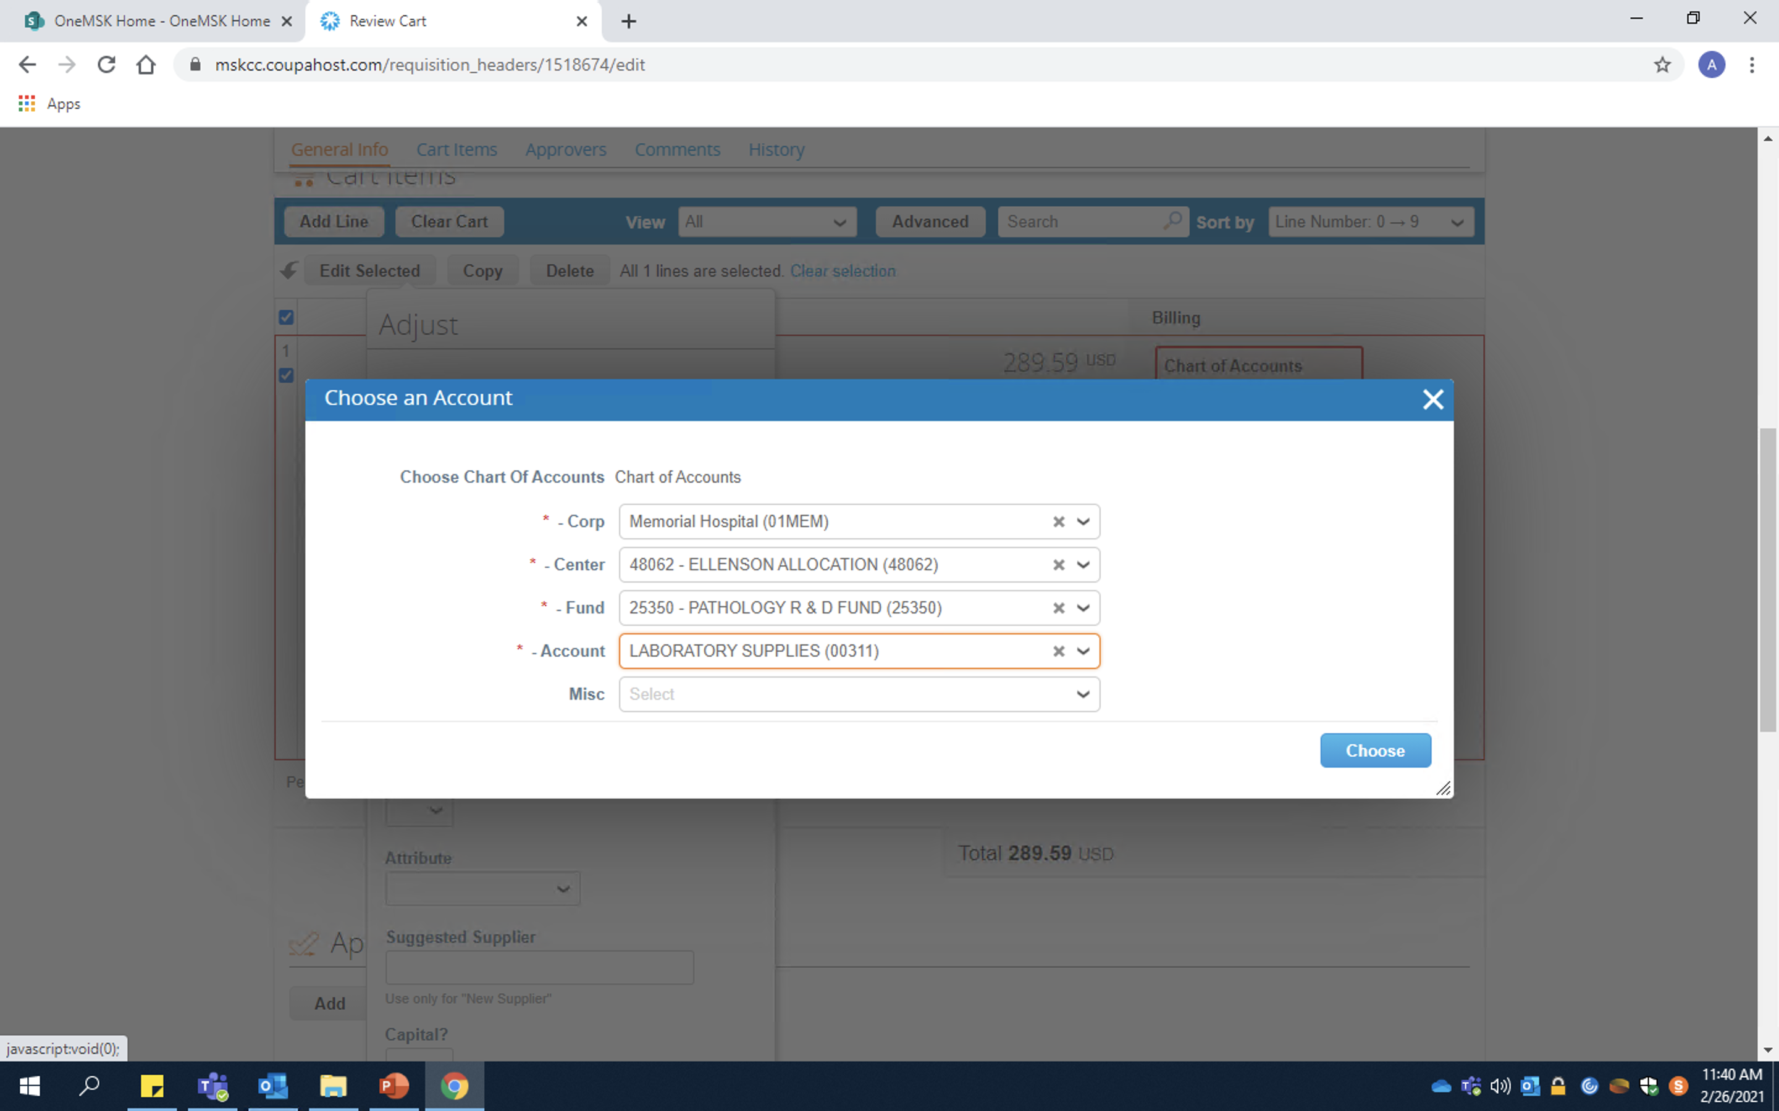
In-Catalog Orders
Corp: Sloan Kettering Institute (01SKI) for SPECTRUM
Note: If unsure what corporation to use, follow these guidelines:
01MEM: 00000 → 49980
01SKI: 50001 → 59980
Center/Cost Center: The first set of numbers provided by your PI
Fund/Fund number: The second set of numbers provided by your PI
Note: Sometimes a cost center will have multiple fund numbers. Be sure you are selecting the correct one!
Account: Provides basic description of items being ordered. I usually use either:
00311: Lab supplies
00340: Chemical

Slide 9
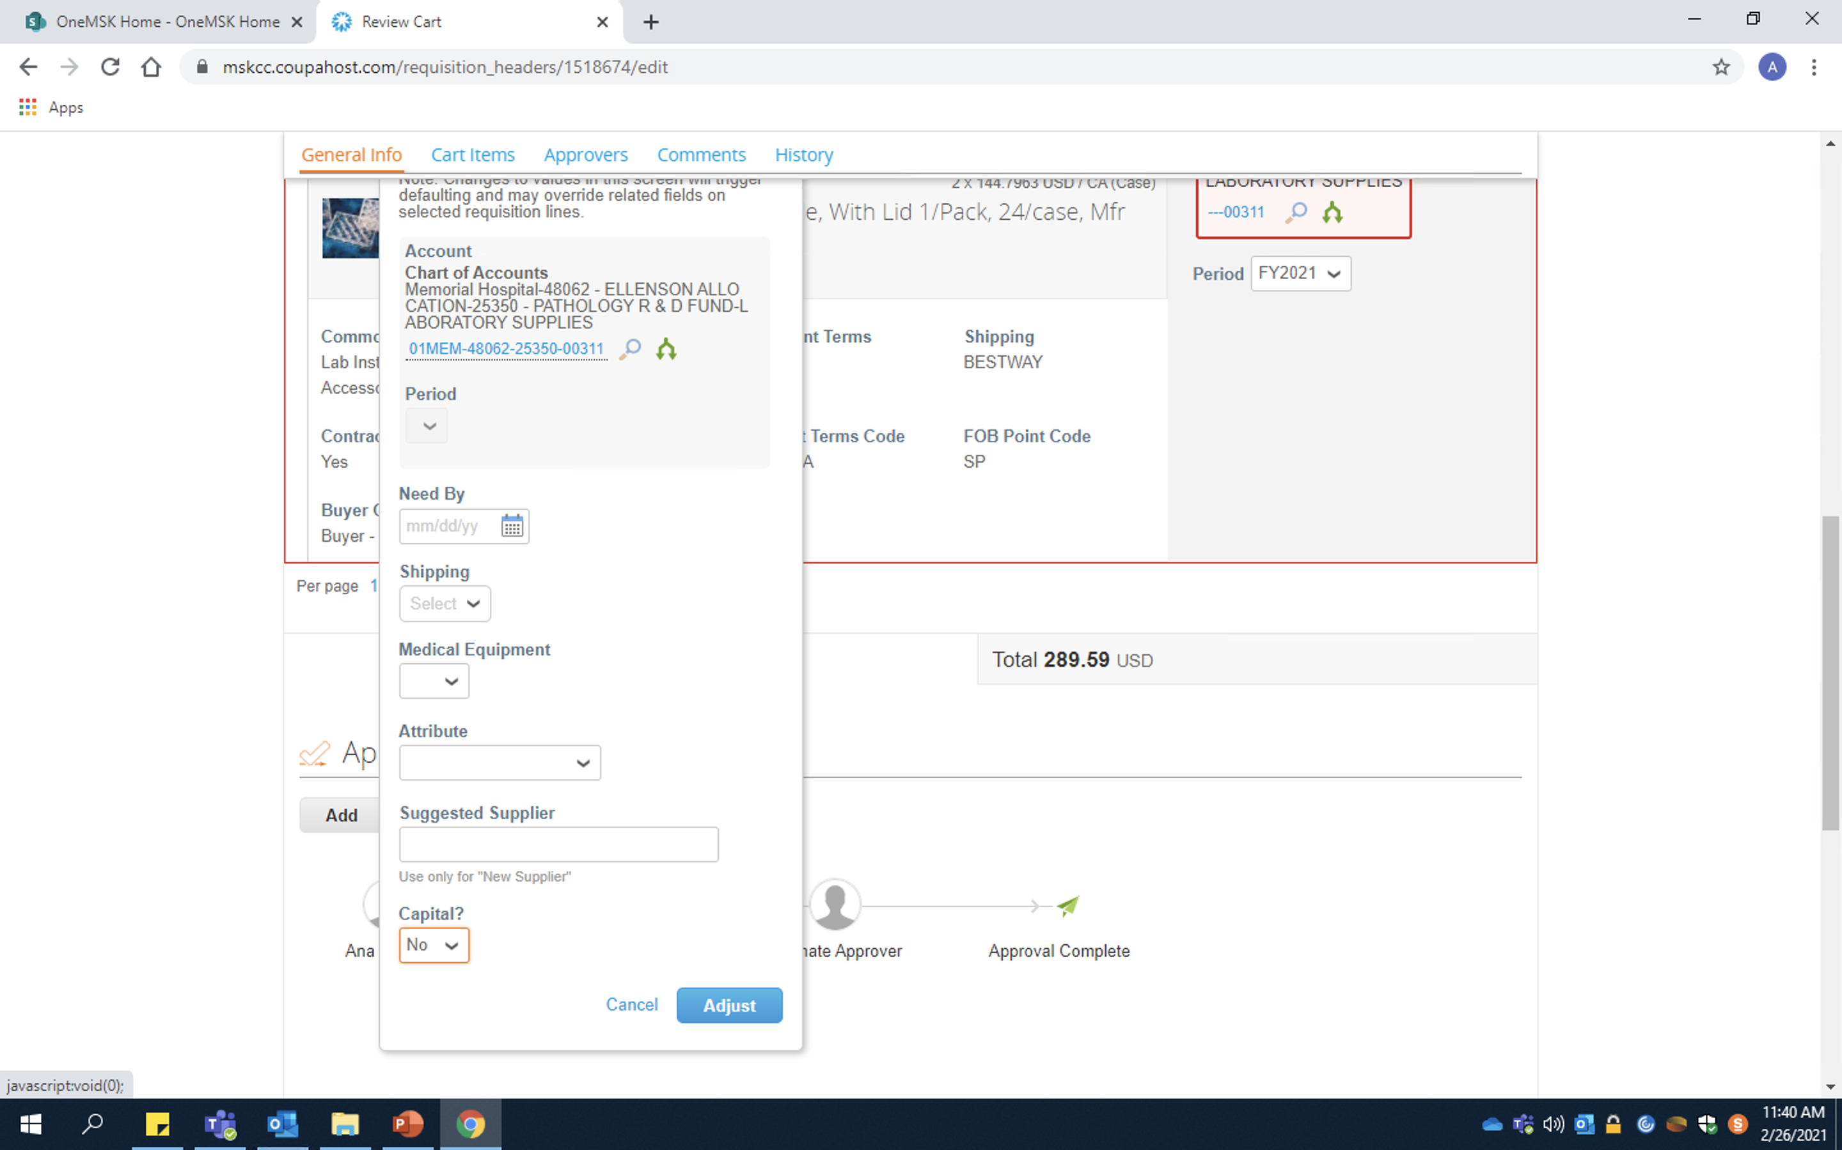
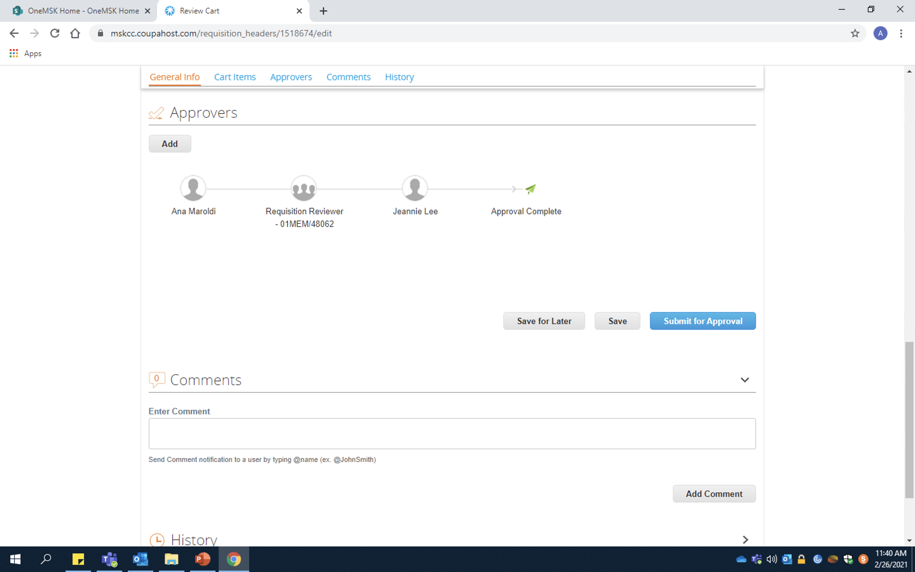
In-Catalog Orders
Indicate this order is not considered Capital
Review all order details then press “Submit for Approval”
DONE !!
Click “Adjust” to save all changes

Slide 10
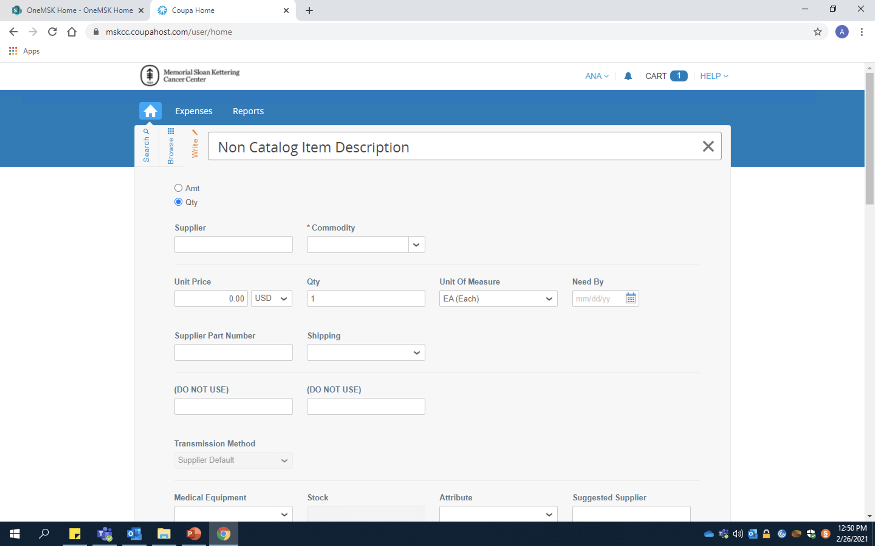
Off-Catalog Orders
If, after pulling out all the stops, you still cannot find the catalog/cat. number you need – you’re probably dealing with an “off-catalog” store request. (RIP)
If possible, it is best to avoid doing off-catalog orders. See if it can be ordered through an in-catalog third party (Usually Fisher or Sigma). However, sometimes items are dramatically more expensive when coming from a third party store. In these cases, talk to the person who needs the item and decide what is best.
NOTE: Off-catalog order requests CANNOT be submitted with in-catalog orders. They MUST be submitted separately.

Slide 11
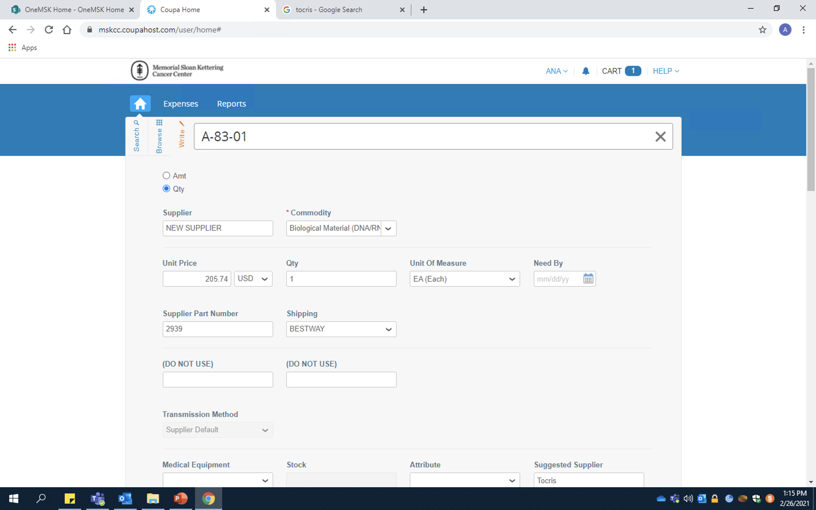
Off-Catalog Orders
Item Description: Place the name of the item as listed in Ziggy/order sheet
Supplier: Every “true” off-catalog will not appear in the supplier drop down. Must select “New Supplier”
Commodity: General category description of item
Unit Price: Pretty Self explanatory. Make sure to edit the quantity and currency if needed
Supplier Part Number: Also known as catalog number

Slide 12
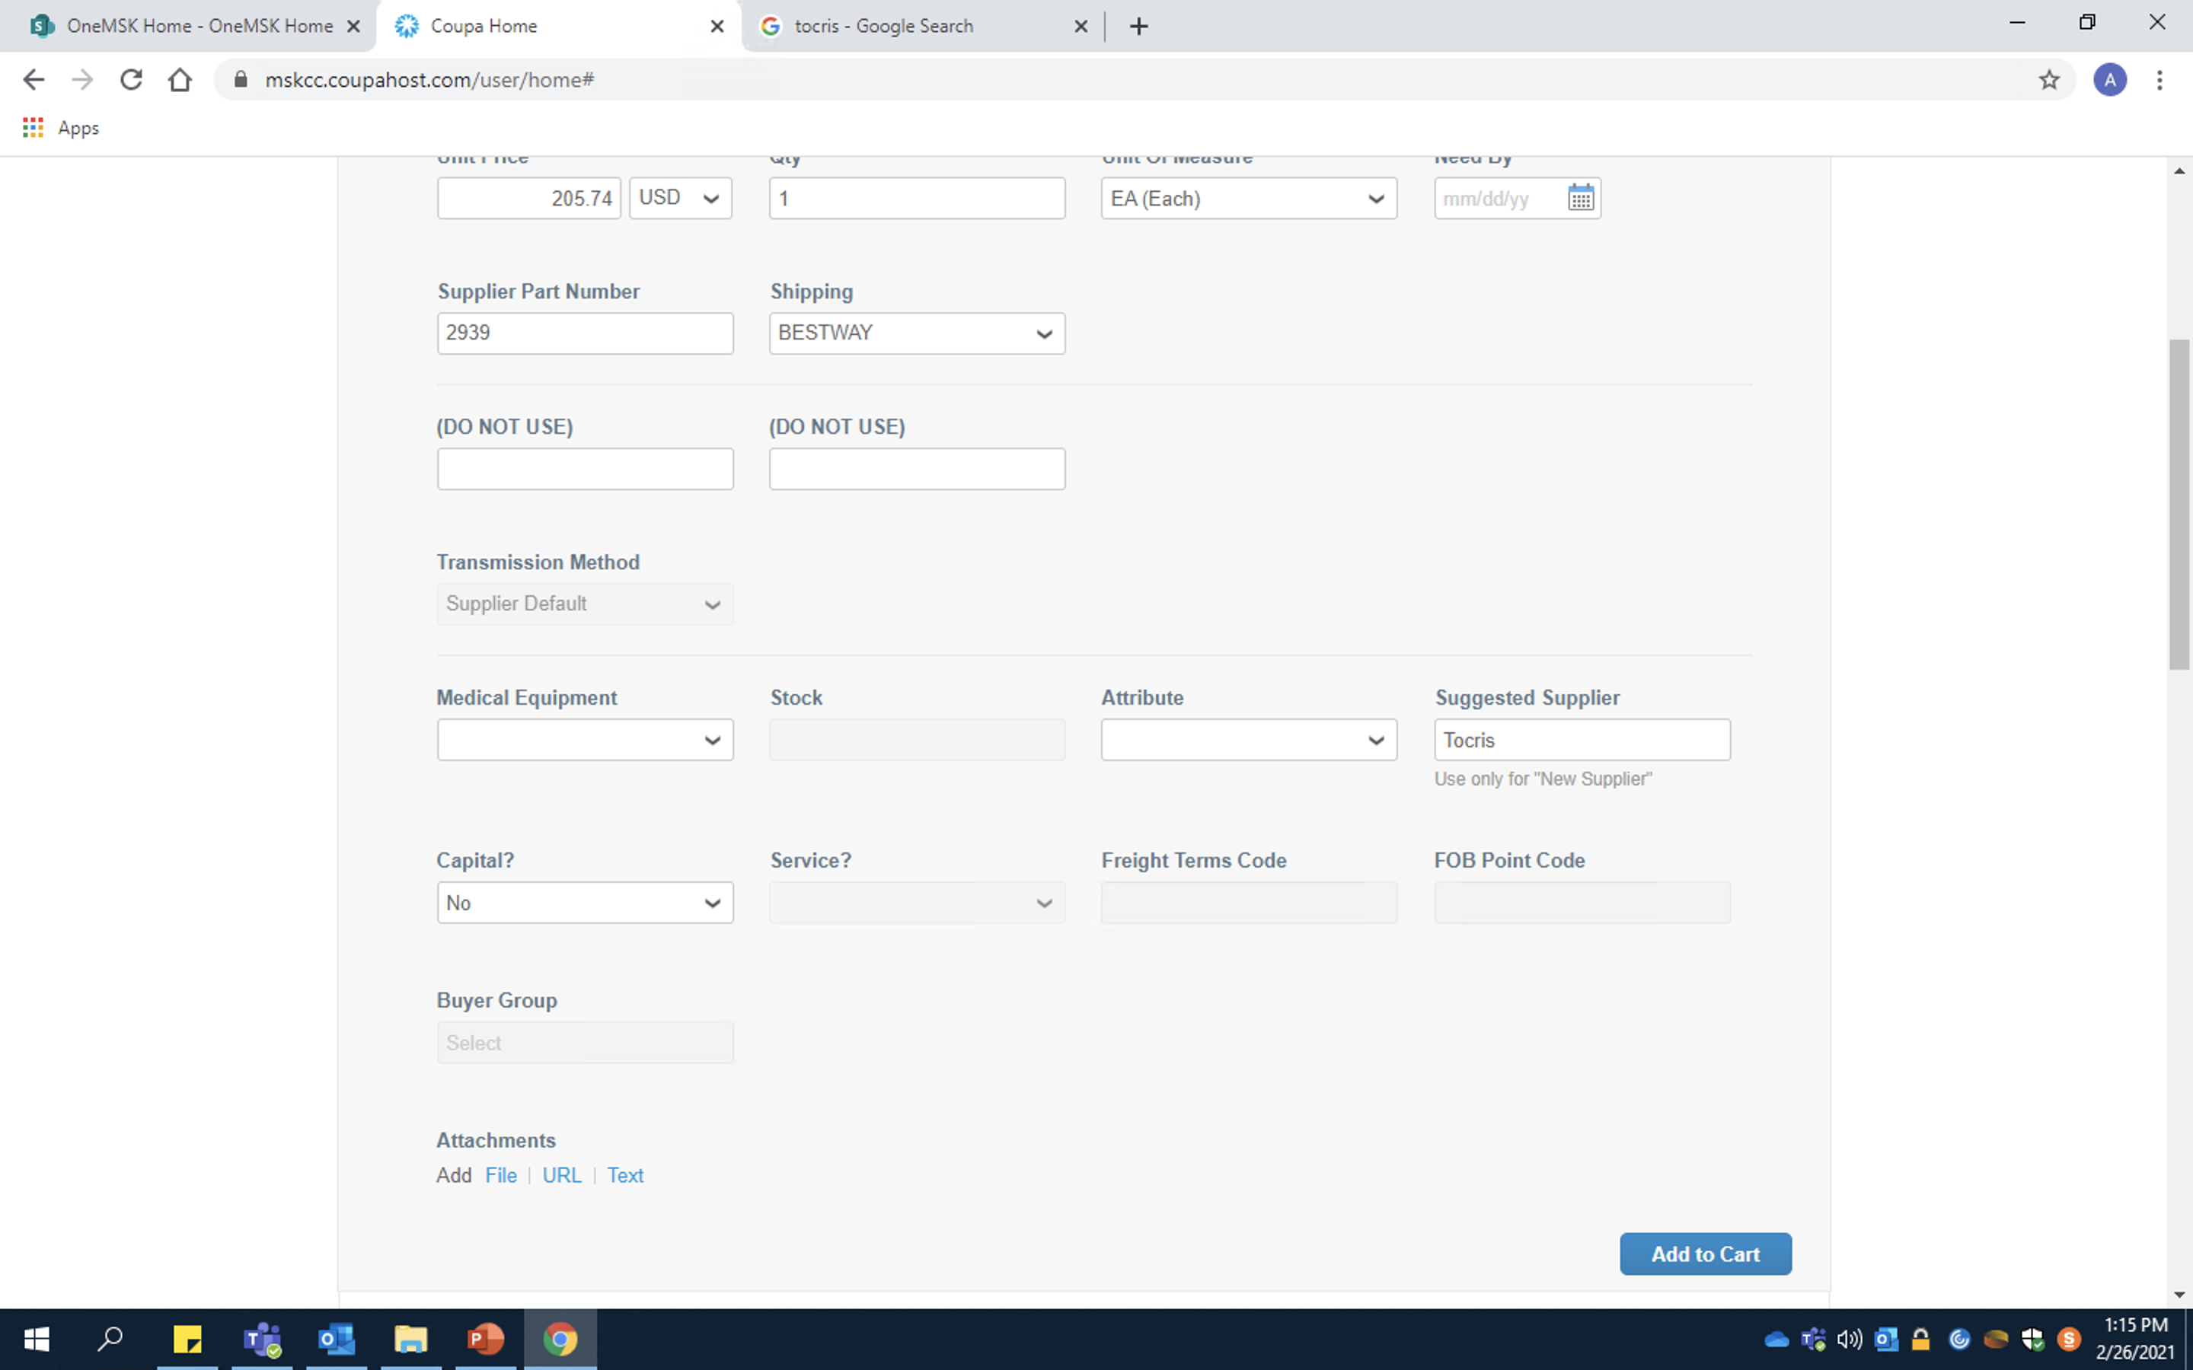
Off-Catalog Orders
Capital: Same as in-catalog orders. Only needed for very large, expensive orders
Suggested Supplier: This is where you indicate the actual name of the off-catalog supplier

Slide 13
Miltenyi Related Orders
Send an Email to Brandon brandong@miltenyi.com, to let him know what products you need and to ask him if there are any promotions for the item. I.e.:
Hi Brandon,
My name is Juliana and I will be ordering for Spectrum with Jamie. If is nice to E-meet you!
We need to order two units of MACS® SmartStrainers (70μm), 4x 25 pcs. Are there any promotions currently going on?
Thank you,
Juliana Niyazov
Then, once he responds, ask him for a quote with the promotion (if applicable). Once he sends it, forward the quote containing the promotion to Cristina raduc@mskcc.org, and ask her to order it.
Make Sure to Update Spectrum Ordering Form (Jamie -> Wet_Lab -> Ordering -> Spectrum Ordering Form).

Slide 14
With all orders, MAKE SURE TO:
- Update Spectrum Ordering Form (Jamie -> Wet_Lab -> Ordering -> Spectrum Ordering Form)
- Save Invoice (Once Item is Received) In Binder

Slide 15
The End

